Slide 1


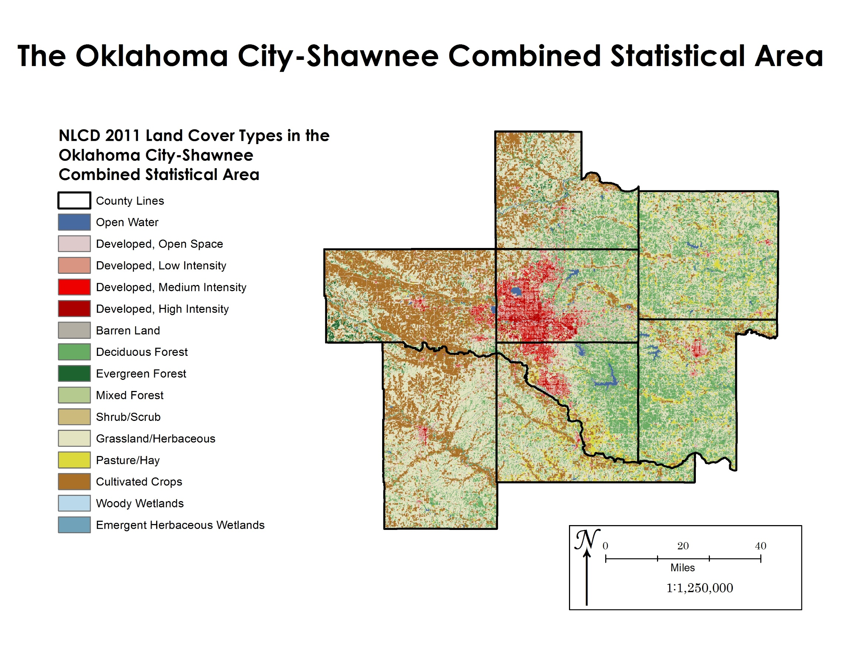
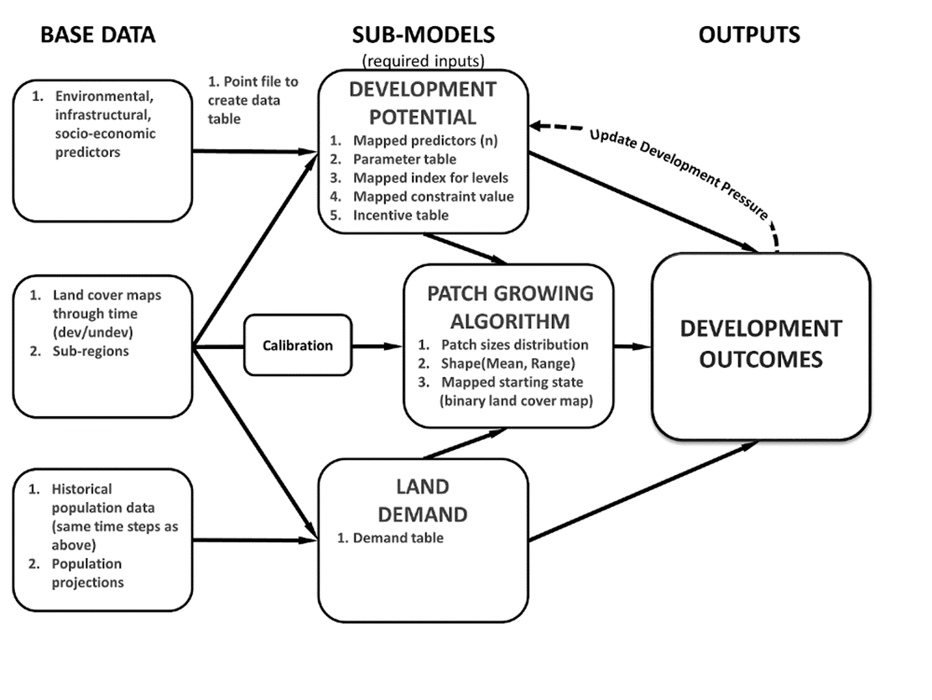
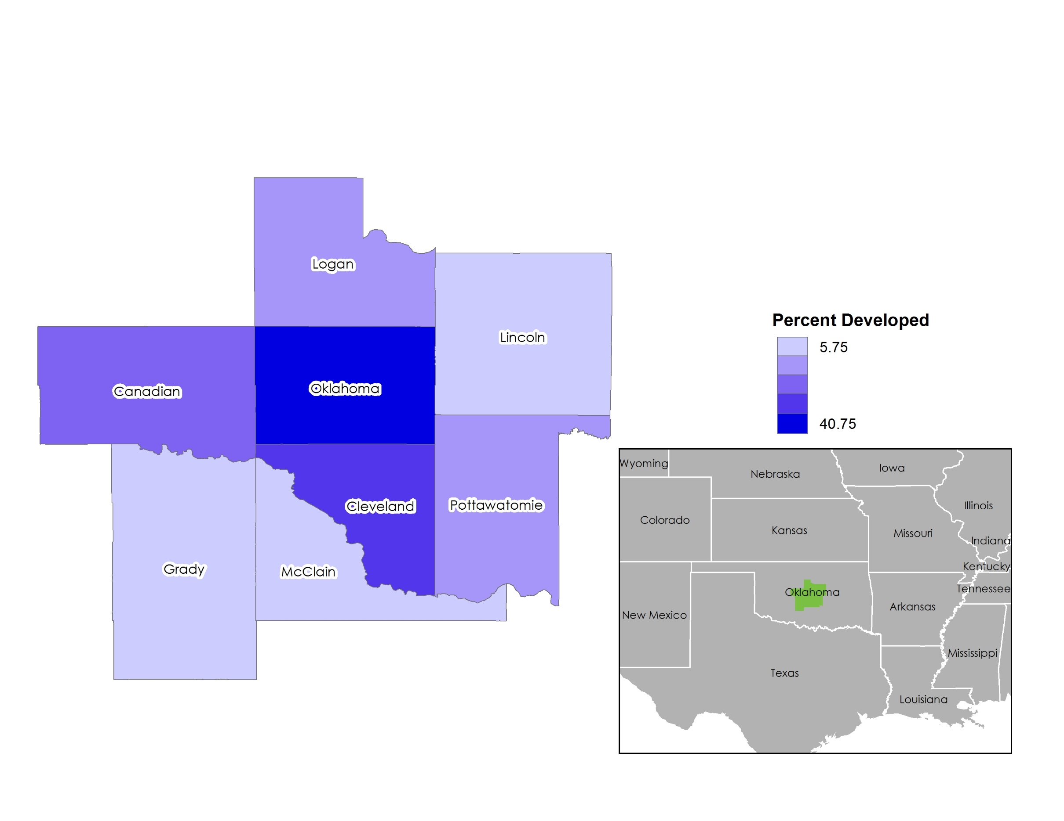
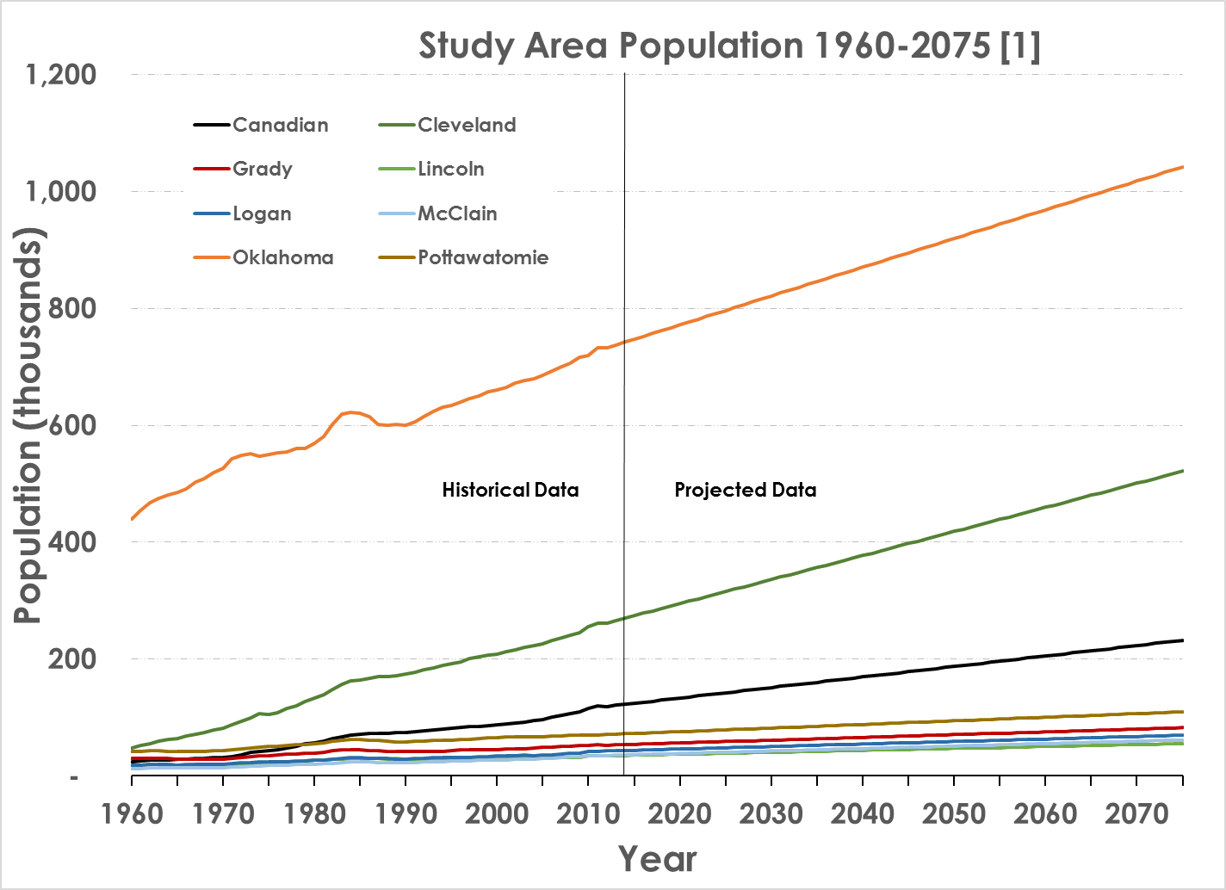
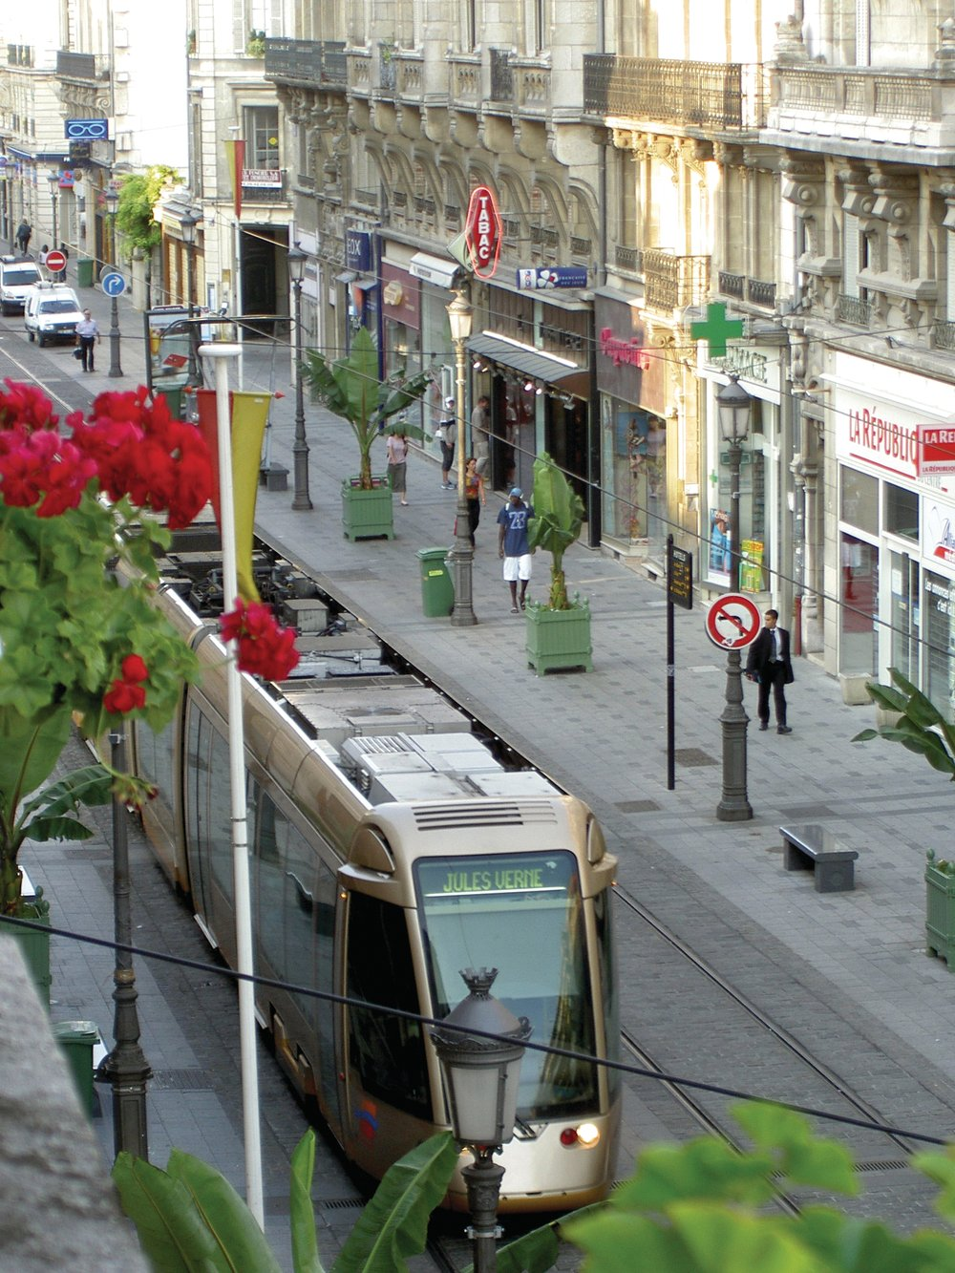
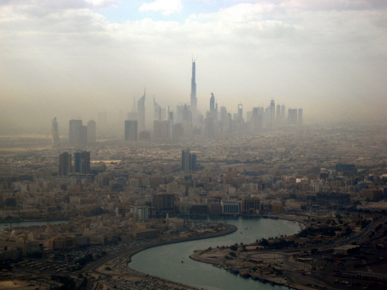
Futures of Oklahoma City – A Scenario Analysis
Claude Buerger and Jennifer Koch
Department of Geography and Environmental Sustainability
University of Oklahoma
background
Scenarios
The Oklahoma City-Shawnee Combined Statistical Area represents the biggest urban area in Oklahoma. It contains numerous urban areas alongside natural areas that represent, among others, economic opportunities, agriculture, and leisure opportunities.
What are potential problems facing Oklahoma?
  Changing Climate
  Density –Where will people choose to live?
  Shift in patterns of living –How will people live?
We are using scenarios to examine potential outcomes under different policy priorities. Some of the scenarios are:
Super Sprawl –a scenario in which all policies on land-use have been relaxed
Status Quo –a scenario which continues current policies into the future
Smart Growth –a scenario which favors infill development and multi-use policies
Futures Model
County From [1] | Oklahoma | Canadian | Cleveland | Grady | Lincoln | Logan | McClain | Pottawatomie
Area (sq. miles) | 718.12 | 905.05 | 558.51 | 1104.3 | 965.79 | 748.69 | 579.45 | 793.39
Population in 2010 | 718,633 | 115,541 | 255,755 | 52,431 | 34,273 | 41,848 | 34,506 | 69,442
Population in 2075 | 1,042,525 | 232,316 | 521,368 | 82,549 | 55,400 | 69,711 | 61,698 | 109,769
Population Density in 2010 | 1000.7 | 127.66 | 457.92 | 47.478 | 35.487 | 55.894 | 59.549 | 87.525
Population Density in 2075 | 1451.74 | 256.68 | 933.49 | 74.752 | 57.362 | 93.110 | 106.47 | 138.35
The FUTure Urban-Regional Environment Simulation (FUTURES) is a model designed around examining the interaction between the rural and developed areas [3]. The FUTURES model consists of three sub-models that interact each time-step to produce a output map. This output map is used in the next time step.
Further Work
In the future we hope to compare our results with the results from the FUTURES—ABM model, which is currently under development. This model uses landowners as agents and simulates peer-influence among agents. We look forward to comparing the results to see if social processes have a large impact on landscape configuration.
References
Metrics
Right: An Example of a Super Sprawl
https://mathieuhelie.files.wordpress.com/2008/10/2117744931_569a8c947b_b.jpg
[1] Barker, S. 2012. “2012 Demographic State of the State Report- OKLAHOMA STATE AND COUNTY POPULATION PROJECTIONS THROUGH 2075.” State Report. Oklahoma Department of Commerce.
[2] McGarigal, K. 2015. “Fragstats Help.” Program Documentation, v. 4.2. doi:10.1016/S0022-3913(12)00047-9.
[3] Meentemeyer, Ross K, Wenwu Tang, Monica A Dorning, John B Vogler, Nik J Cunniffe, and Douglas A Shoemaker. 2013. “FUTURES : Multilevel Simulations of Emerging Urban – Rural Landscape Structure Using a Stochastic Patch-Growing Algorithm FUTURES : Multilevel Simulations of Emerging Urban – Rural Landscape Structure Using a Stochastic Patch-Growing Algorithm.” Annals of the Association of American Geographers 103 (4): 785–807. doi:10.1080/00045608.2012.707591.
This material is based on work supported by the National Science Foundation under Grant No. OIA-1301789.
Contact:
Claude Buerger
Master’s Student & Graduate Research Assistant
Email: cbuerger4@gmail.com
We are using several metrics to analyze the output of the FUTURES Model regarding spatial configuration. The implementation of these metrics is based on the FRAGSTATS documentation [2]. We are using the following metrics:
Cluster Size Frequency –A tabulation of what size of cluster or patch appears most frequently.
Edge Density –A comparison of the edge length to the total area of a patch.
Fractal Dimension –A metric that looks at the regularity of the shape of a patch.
Perimeter –The total length of the edges of the patch.
Left: An Example of a Smart Growth Scenario
http://www.railforthevalley.com/wp-content/uploads/2010/06/512647_0_1.jpg

