Slide 1
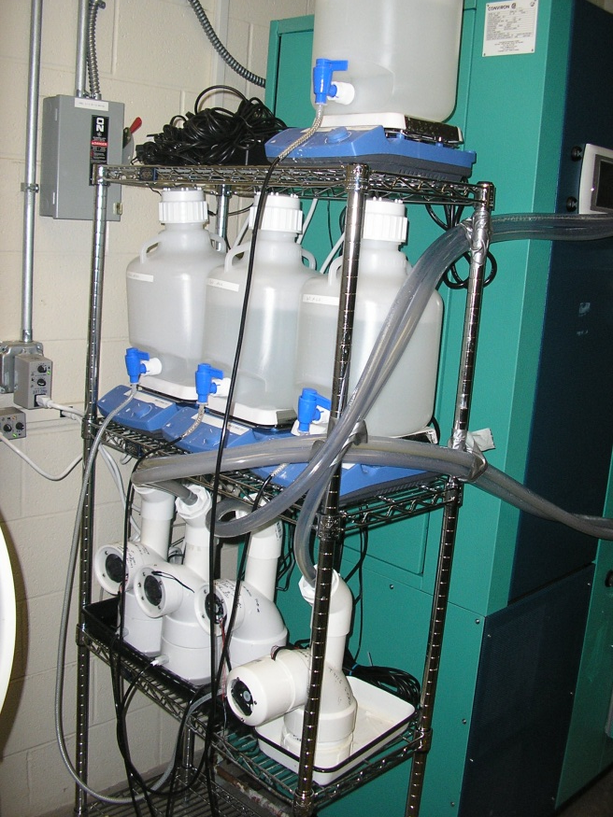
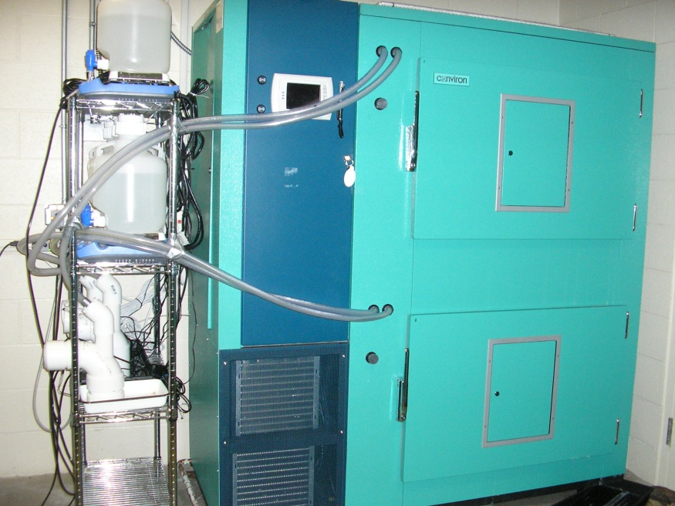
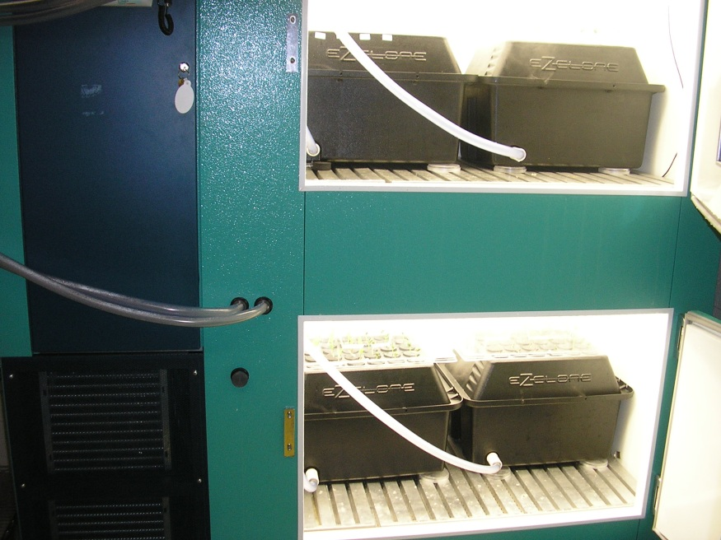
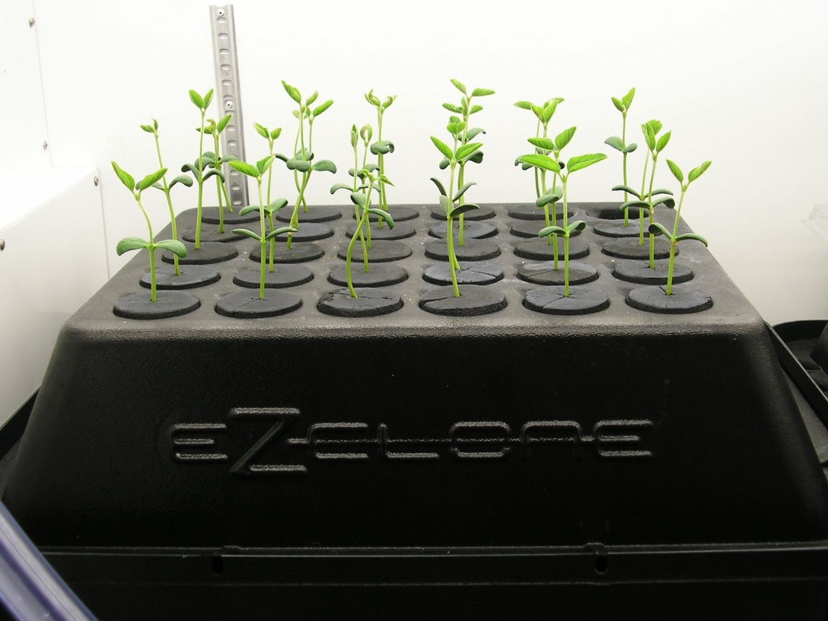
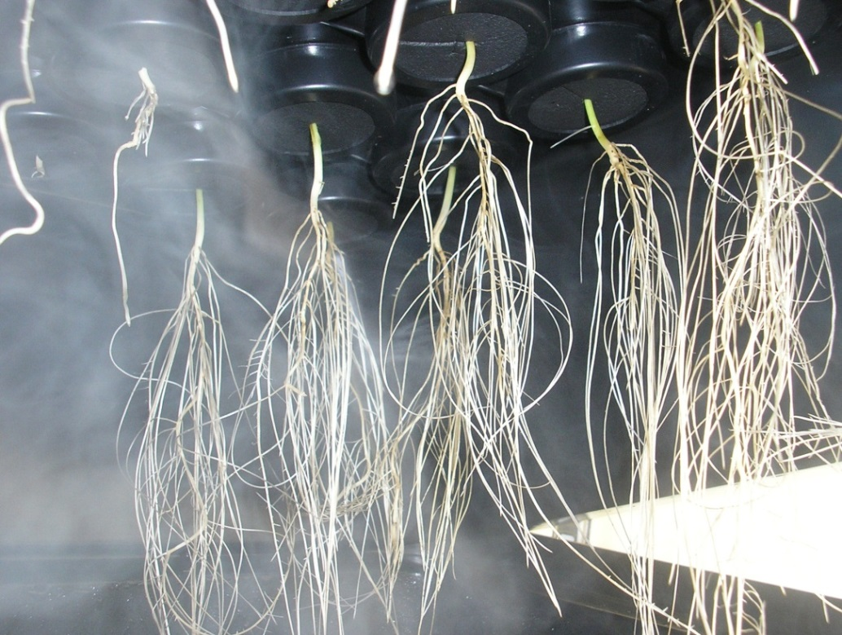
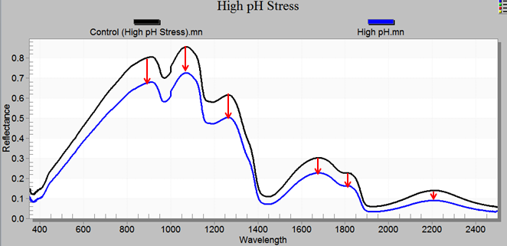
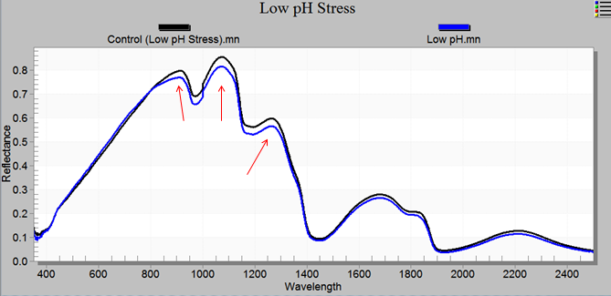
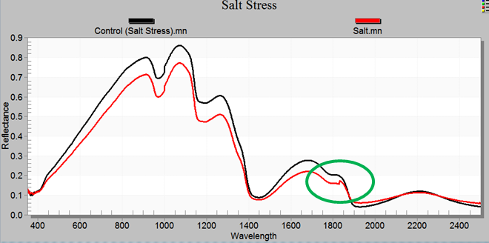
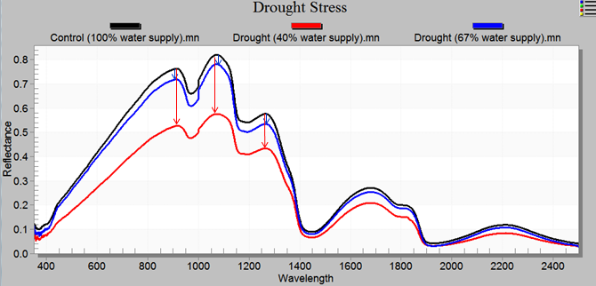
Use of remote sensing technology to phenotype crop root response to
climate change and environmental stresses
Jennifer Brooks, Zhenhua Zou, Xiangming Xiao, Marc Libault
Department of Microbiology and Plant Biology, University of Oklahoma, Norman, OK, 73019
Plants, and especially their root systems, are highly sensitive to environmental stresses. Remote sensing technologies are currently used on the canopy to record light reflectance spectra, revealing the level of stress of plants growing under unfavorable environmental conditions. Here, we are proposing a new application of remote sensing technology to phenotype the response of plant root systems growing under unfavorable conditions (e.g., drought and extreme salinity). To reach this objective, we are combining remote sensing and ultrasound aeroponic technologies. The latter (Figure 1) allows for the complete control of the environment that the plants are exposed to and provides easy and instant access to the plant root systems compatible with the use of remote sensing technology. To validate this strategy, we analyze changes in the light reflectance spectra of the soybean root system in response to limited and extreme drought as well as elevated salinity and extreme pHs (Figure 2). This research project will ultimately lead to the development of a new, quantitative and reproducible method to characterize the early response of plants to various environmental stresses.
(A)
(B)
(C)
(D)
(E)
Figure 1. The ultrasound aeroponic system allows for complete control of plant growth environment. Nutrient solution that is converted to mist by the ultrasound mister units is used to feed and water the plants in the growth chamber (A, B) . In the chambers, 8-day-old soybean plant are growing in cloner units (C, D). This technology allows for the treatment of the plant root system and provides direct access to the root system, which is compatible with the use of remote sensing technology (E).
(A)
(B)
(C)
(D)
Figure 2. Signature spectra of the soybean root system growing under high pH (A), low pH (B), extreme salinity (C), and limited/extreme drought stresses (D). The spectra of the root system of soybean plants growing under optimal conditions are indicated in black as controls.

