Slide 1
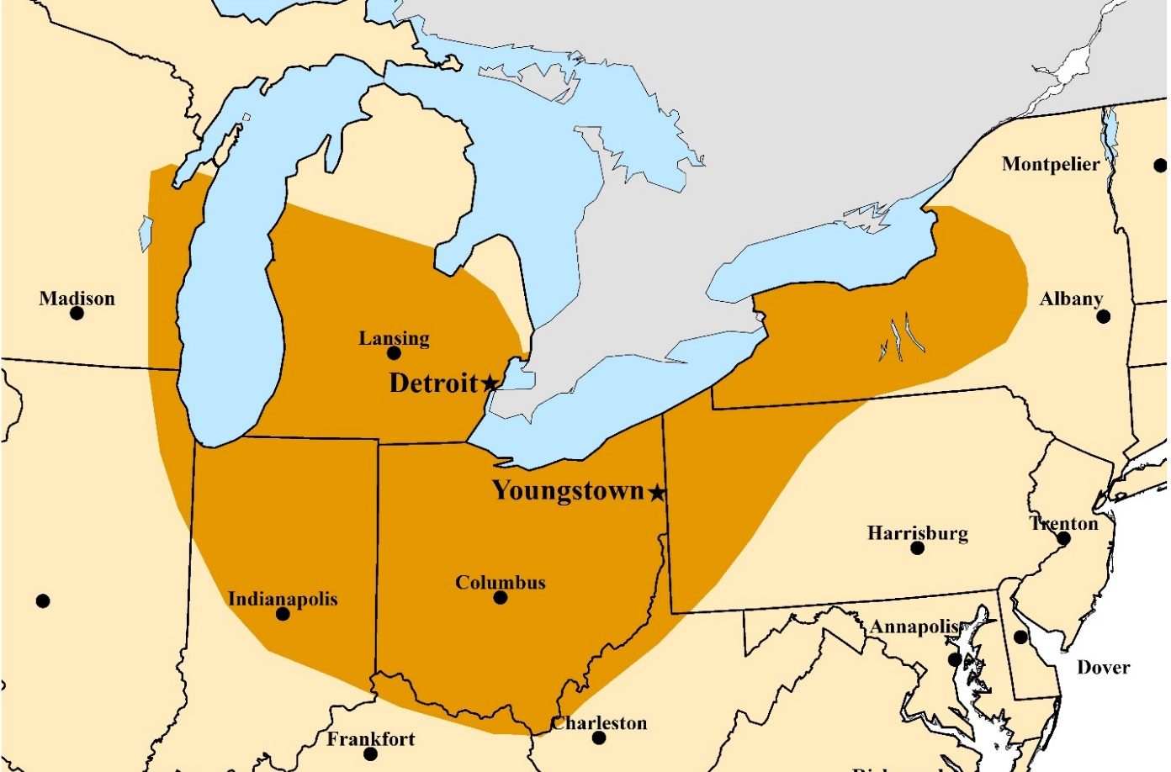
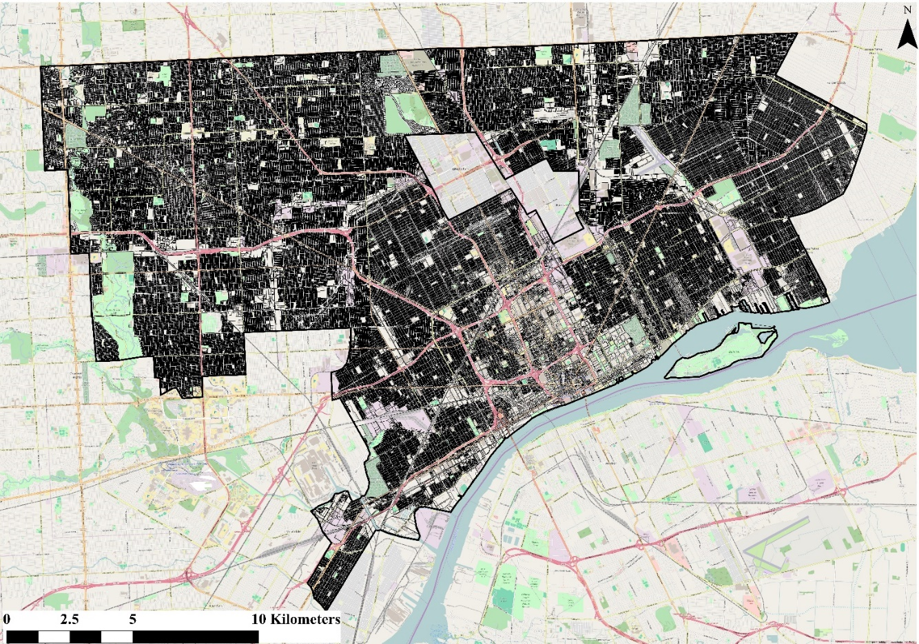
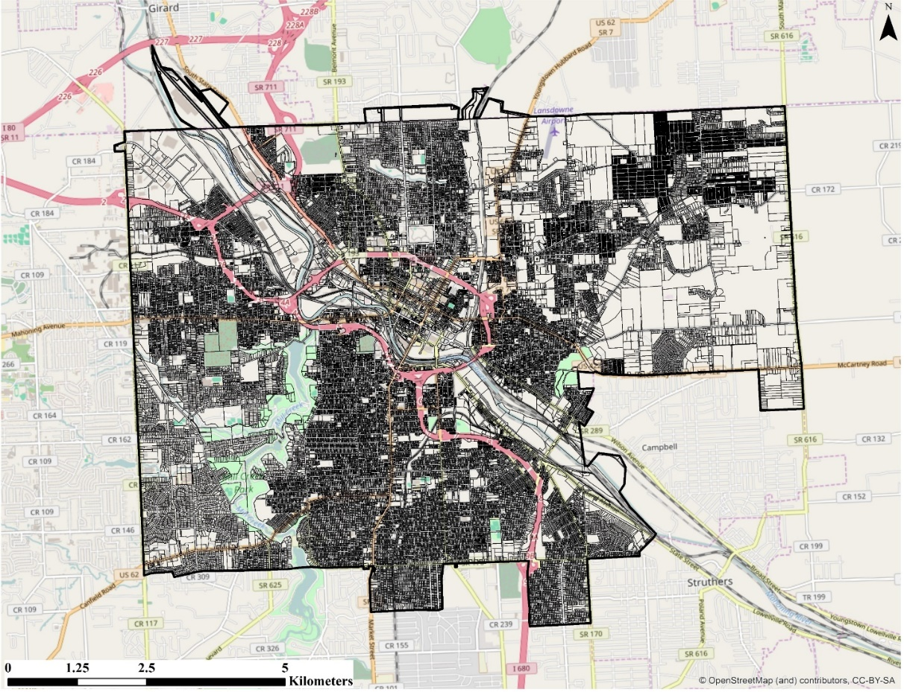
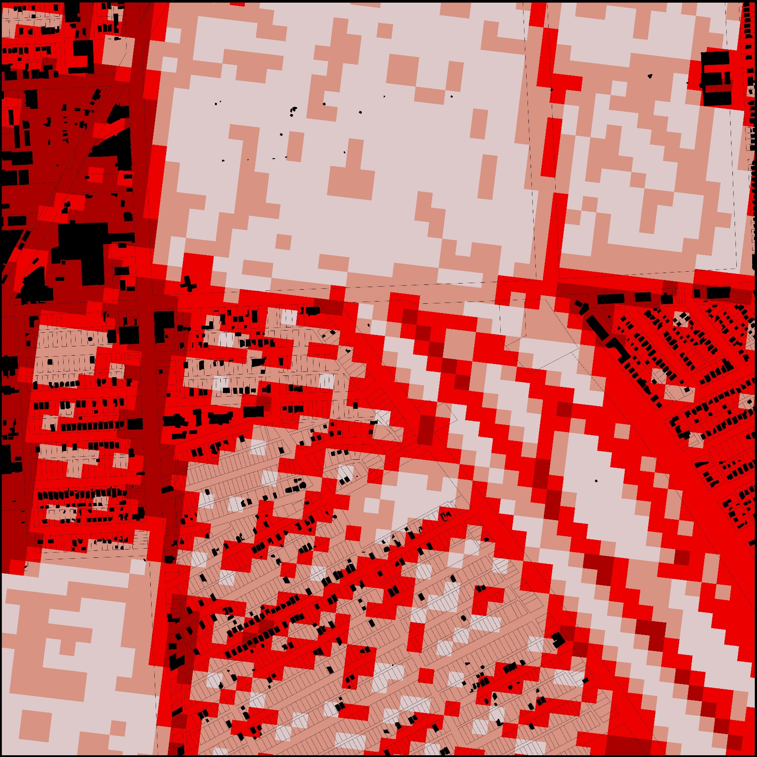
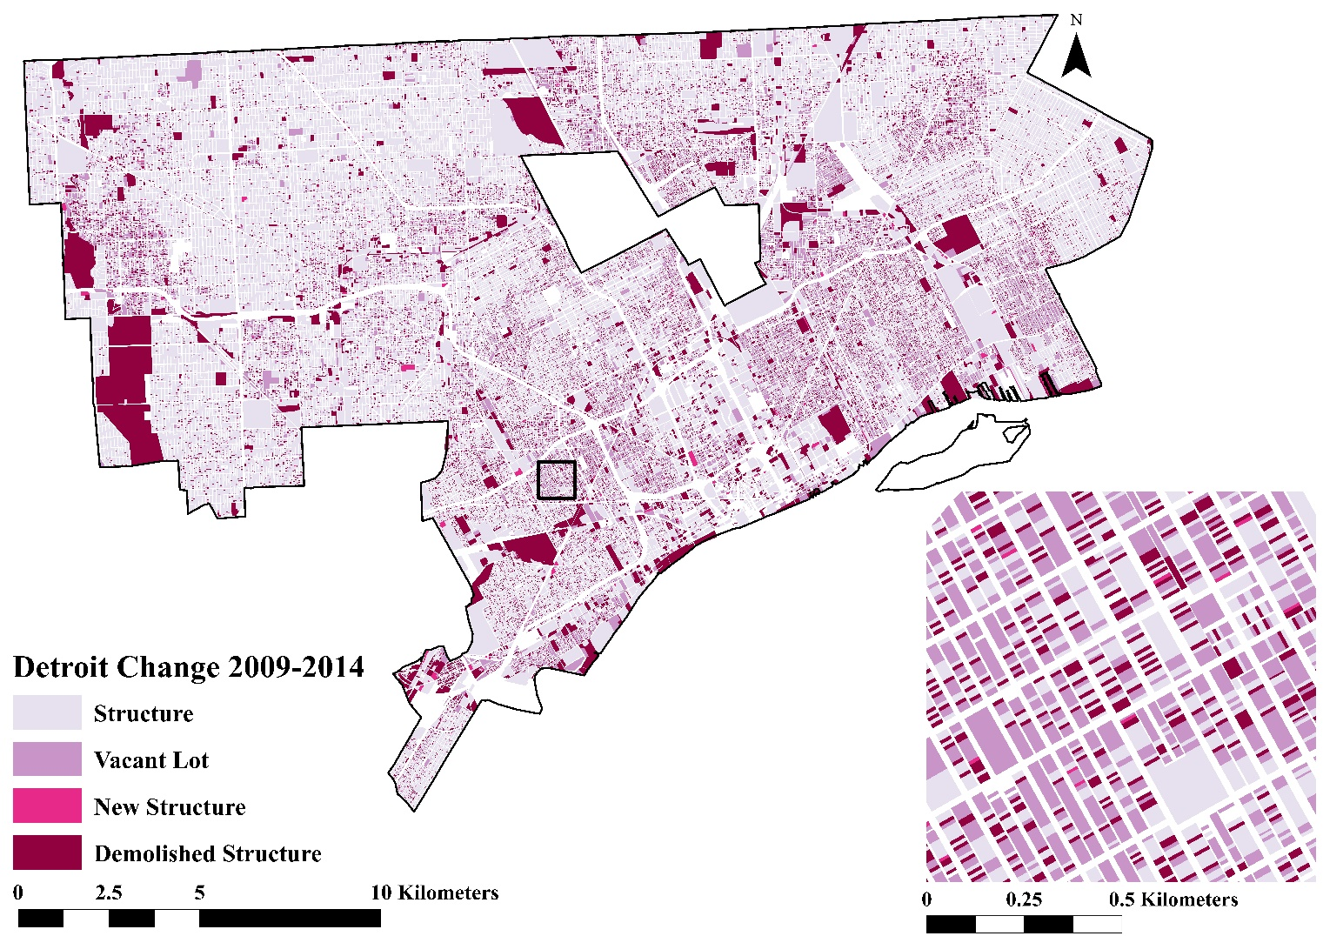
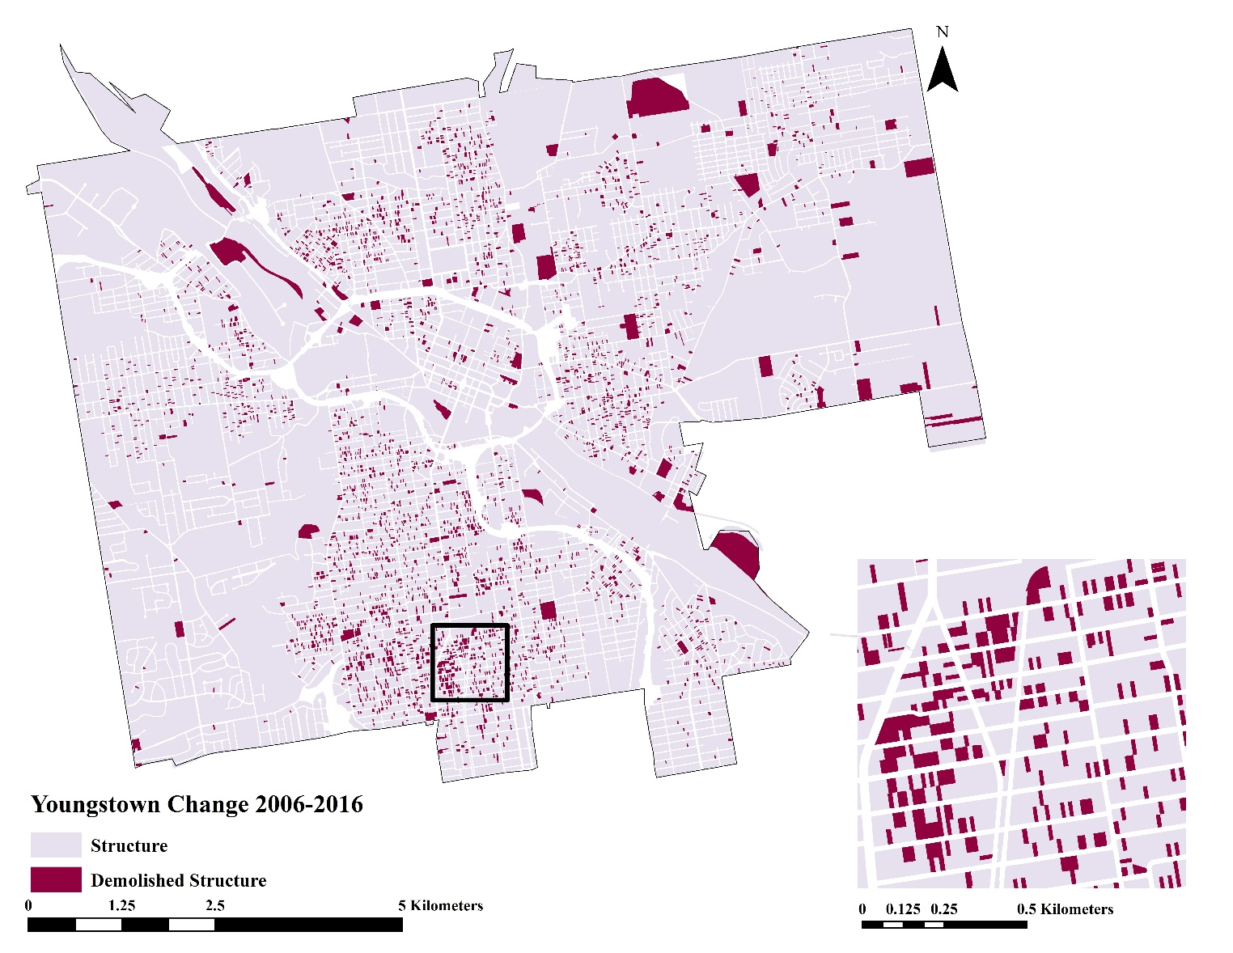
Mapping land cover change in rust belt shrinking cities with LIDAR and GIS
Emily Thompson, Kirsten de Beurs
Department of Geography and Environmental Sustainability, College of Atmospheric & Geographic Sciences, University of Oklahoma
esthompson@ou.edu, kdebeurs@ou.edu
A. Overview
B. Study Areas
C. Ineffective Approach
The Rust Belt region of the United States was once the beacon of industrial and economic power, but today is characterized by declining populations. While many studies examine these shrinking cities in the realm of socio-economic implications, there is a lack of research that investigates the physical artifacts of drastic population loss. This study aims to fill that void by examining land cover change in the Rust Belt shrinking cities of Detroit, Michigan and Youngstown, Ohio. Detroit has served as the poster-child for population decline, having experienced a loss of 62% from its peak population in 1960 to 2010. In Detroit we use LIDAR data to extract building footprints which are then compared to property survey data to create a 5-year land cover change map that highlights demolished properties. Youngstown has seen a 60% decline in population from its peak in 1930 to 2010. Here, demolition records are used to map structural loss for a 10-year time period. These case studies provide, in high detail, a snapshot of what the contemporary urban landscape of the American Rust Belt looks like today. Additionally, we challenge the use of the NLCD and products of similar resolution in shrinking cities.
a)
b)
Conventional freely-available remote sensing products and derived products such as the National Land Cover Dataset have resolutions of 30m or coarser.
Although a 30m resolution is beneficial for general land cover type classification and analysis, it can often miss small details such as houses.
These details are crucial in shrinking cities because land cover change is dominated by the loss of structures.
Figure 3 (left) shows a 2.25 km² area of Detroit (described in Box D) using the 2011 NLCD Land Cover product’s Developed classes, building footprints, and land parcels.
The 30m pixels do not accurately describe the land cover when trying to examine structures and land at a parcel scale.
It is necessary to use other approaches that will take small details on the landscape into consideration.
Figure 2: a) (Left) Municipal boundary and land parcels of Detroit, Michigan. b) (Right) Municipal boundary and land parcels of Youngstown, Ohio.
Figure 1: The Rust Belt Region of the United States includes industrial centers of the metals and automotive industries.
Detroit, Michigan
Youngstown, Ohio
The Rust Belt expands from western New York state west into far east Illinois and portions of Wisconsin.
Starred are Detroit, Michigan and Youngstown, Ohio which were selected because they represent significantly different populations and land areas.
Spans 370 km² in Wayne County in southeast Michigan and sits along the Detroit River, which flows into Lake St. Clair to the northeast and Lake Erie to the southeast (Figure 2a.)
Study area excludes the centralized communities of Highland Park and Hamtrack.
Reached maximum population of 1.85 million in 1960, but has declined by 62% to 711,000 by 2010.
Expands 90 km² in eastern Ohio and is primarily located in Mahoning County. Some parcels stretch into Trumbull County (Figure 2b.).
Reached peak population of 170,000 in 1930, but has declined by 60% to 67,000 by 2010.
Figure 3: Building footprints and land parcels overlaid onto the 2011 NLCD Land Cover product Developed classes.
D. Light Detection and Ranging (LIDAR) in Detroit
a)
b)
c)
d)
205 2.25 km² LIDAR scenes from the USGS Earth Explorer website for Detroit from the 2009 USGS Wayne County LIDAR dataset (Figure 4).
One 2.25 test scene displayed in Figure 5.
Building detection performed using ENVI LIDAR™ workflow.
Raw LIDAR LAS files are imported into the software.
Points identified as buildings based on classification, elevation, and slope between points are segmented and connected to form likely buildings.
Building footprints are extracted. They were then overlaid onto parcel data.
Parcels of land in Detroit were classified as having contained a building footprint or not having contained a footprint
The 2009 classified parcels were used as a base year for land cover change analysis.
Efficiency of building detection workflow validated using 2009 Detroit Residential Parcel Survey.
LIDAR correctly identified 88% of the structures present in 2009.
Figure 4: We used 205 LIDAR scenes in Detroit. The highlighted scene is used to show a sample of the building detection and parcel classification process in Figure 5 (right).
Figure 5: Workflow of feature extraction from LIDAR data to classify parcels of land in Detroit in 2009.
E. Land Cover Change Using LIDAR and Motor City Mapping
F. Demolition in Youngstown
Motor City Mapping Winter 2013-2014 Certified Results dataset
Referred to as MCM for this study
Survey data conducted in Detroit of 380,000 property parcels
Provided detailed information such as residency status, property type, structural status, structural condition, fire damage, etc.
Structural status was the data category used for this study to classify parcels for 2014
Structures and vacant lots
Land cover change analyzed on a parcel scale
Products of 30 m resolution or higher are too coarse to capture significant small changes to the landscape
Demolition data was collected by the City of Youngstown Property Code Enforcement and Demolition Office.
LIDAR data exists for 2006 for this area, but it is unclassified and of poor quality. Therefore it was deemed ineffective for this immediate study.
Annual demolition records range from 2006-present and are updated frequently.
Motor City Mapping
Motor City Mapping Winter 2013-2014 Certified Results dataset
Referred to as MCM for this study
Survey data conducted in Detroit of 380,000 property parcels
Provided detailed information such as residency status, property type, structural status, structural condition, fire damage, etc.
Structural status was the data category used for this study to classify parcels for 2014
Structures and vacant lots
10-year Change Map
61,387 total parcels in Youngstown
Figure 7 (left) shows a small scale map of the 10-year change for Youngstown using only demolition records.
Showcases structural loss
Structure – a structure was present from 2006-present.
Demolished Structure – a structure was demolished in the time frame from 2006-2016.
A large scale 1 km² area of southern Youngstown is shown
The demolition data identified a 6% total loss in the number of structures from 2006-2016.
5-year Change Map
The classified 2014 parcels were compared to those from the 2009 LIDAR data in order to examine change over 5 years
Figure 6 (left) shows a small scale map of the 5-year change for the city of Detroit using four categories
Structure – a structure was present in both 2009 and 2014.
Vacant Lot – a vacant lot (lack of structure) was present in both 2009 and 2014.
New Structure – a structure was not present in 2009, but present in 2014.
Demolished Structure – a structure was present in 2009, but not present in 2014.
A large scale 1 km² area of southern Detroit is shown
In total, there was a 13% loss in the total number of structures from 2009-2014.
Figure 7: 10-year demolition change in Youngstown
G. Conclusions
Conventional methods of mapping land cover change in urban areas are ineffective in shrinking cities because small changes in the landscape have the potential to be overlooked.
LIDAR is able to detect features at high resolutions and is ideal for change analysis where small features need to be considered
The major disadvantage is that multi-temporal availability is limited
Large survey datasets are available for the City of Detroit, but not for other cities who have experienced similar socio-economic issues.
Various types of GIS data, such as demolition records, can be used as a proxy for imagery data to classify land cover and perform change analysis.
The use of freely available data allows for this type of study to be reproduced for several shrinking cities in the Rust Belt.
Figure 6: Land cover change on a parcel scale of Detroit using LIDAR in 2009 and MCM in 2014.

